Slide 1

DEPARTMENT OF COMPUTER SCIENCE & ENGINEERING
CS451 & SEMINAR AND PROJECT PRELIMINARY
Second Review
Date:
Notes:
Welcome the participants to the program.
Introduce yourself and briefly summarize your experience at EY and your interest in presenting at Welcome to EY.
Have co-facilitators, if present, introduce themselves and provide background information.
State the following to help participants understand the context of Welcome to EY:
This course was designed for all ranks around the globe. It provides you with foundational knowledge that will help to explain our culture, our processes and how we go to market.
However, your service line will provide the specifics about your role and your job.
As an organization, we want to invest in you, give you consistent content globally, let you meet other new hires across service lines and meet some of our leaders.

Slide 2
Contents
Team and Guide Details
Abstract
Objectives
Design Diagrams
Technology Used
References
Notes:
Make the following points:
Here you see our four Areas. Across our geographies we operate in approximately 150 countries, offering us worldwide reach. EY has over 190,000 people across the globe.
Our services are provided within four service lines:
Assurance
Advisory
Tax
Transaction Advisory Services (TAS)
Explain that these will be covered in more detail a bit later.

Slide 3
Team and Guide Details
Project Name: TeachAR
Team Members
Christy Varghese
Amal Anto
Hanna Elsa Reni George
Jiya George
Guide Name: Prof.Bino Thomas
Notes:
Make the following points:
Here you see our four Areas. Across our geographies we operate in approximately 150 countries, offering us worldwide reach. EY has over 190,000 people across the globe.
Our services are provided within four service lines:
Assurance
Advisory
Tax
Transaction Advisory Services (TAS)
Explain that these will be covered in more detail a bit later.

Slide 4
Abstract
In current pandemic situation educational institutions shifted their base to virtual platforms.
Virtual method is not as effective as the traditional education system.
Students, especially school students are not able to fully understand the concepts.
Explaining the structure of different objects is difficult.
Notes:
Make the following points:
Here you see our four Areas. Across our geographies we operate in approximately 150 countries, offering us worldwide reach. EY has over 190,000 people across the globe.
Our services are provided within four service lines:
Assurance
Advisory
Tax
Transaction Advisory Services (TAS)
Explain that these will be covered in more detail a bit later.

Slide 5
Objectives
Teachers can teach by screen sharing with students using 3D models of various.
The system is designed based on the syllabus of the Kerala State Education Board. Thus promoting the state syllabus education system.
Allows students teacher interaction.Thus making learning a fun and memorable experience.

Slide 6
Modules
Login and Registration module:
Teachers login module
Name
Subject
School name
Email id and user id
Password
Students login module
Name
School name and class
Email and user-id
Password
Date of Birth

Slide 7
Modules
Courses
Course name
Chapters
AR-Models
Model name
Description
Function
360° view
Forums
Class
Subject
Chapter

Slide 8
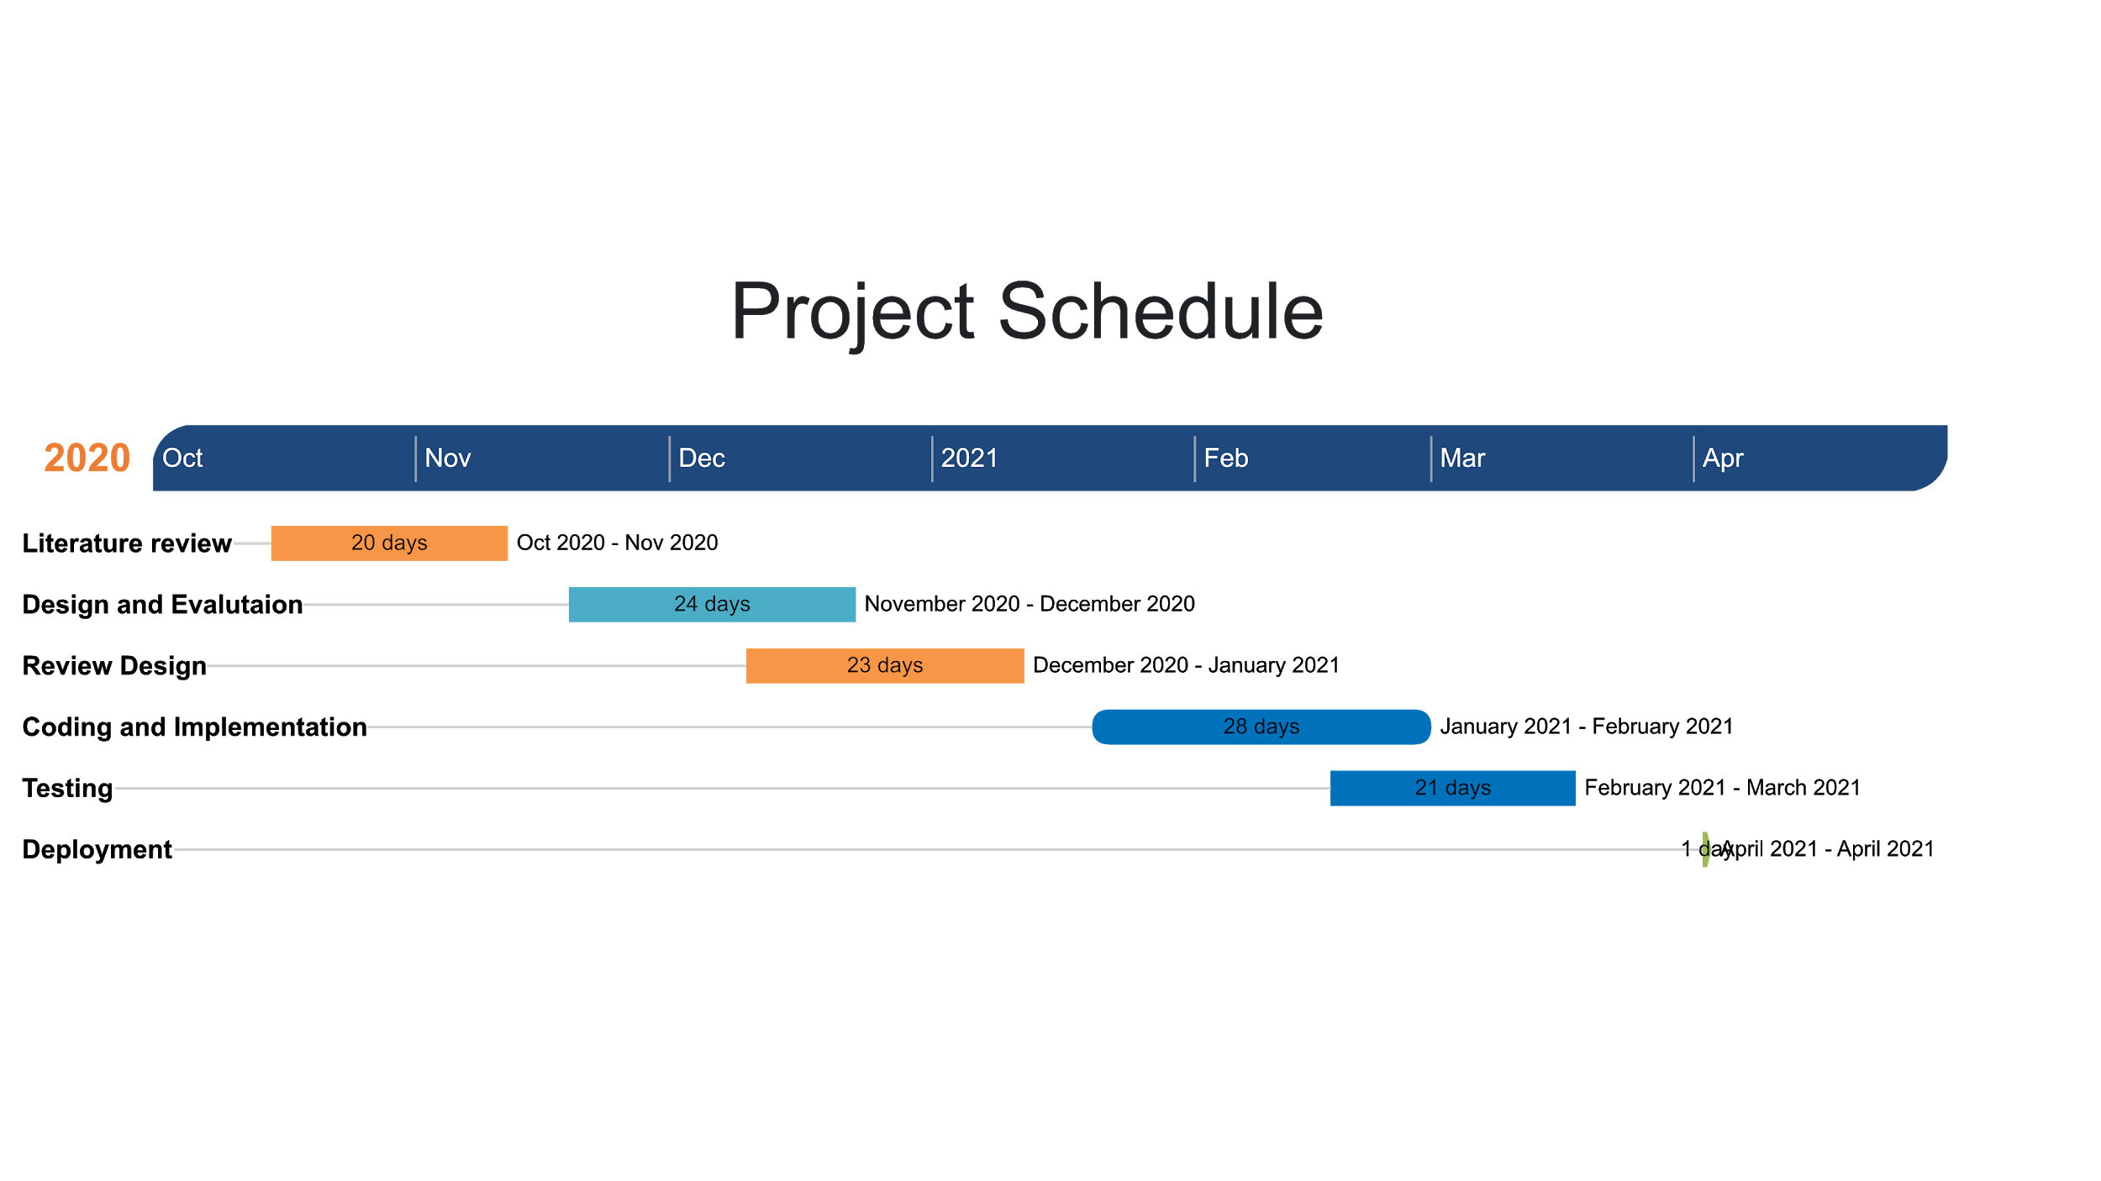
Gantt Chart

Slide 9
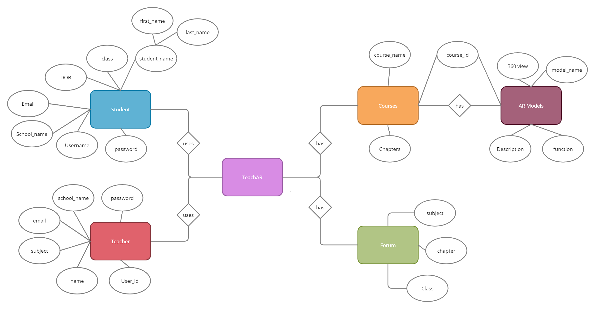
ER Diagram

Slide 10
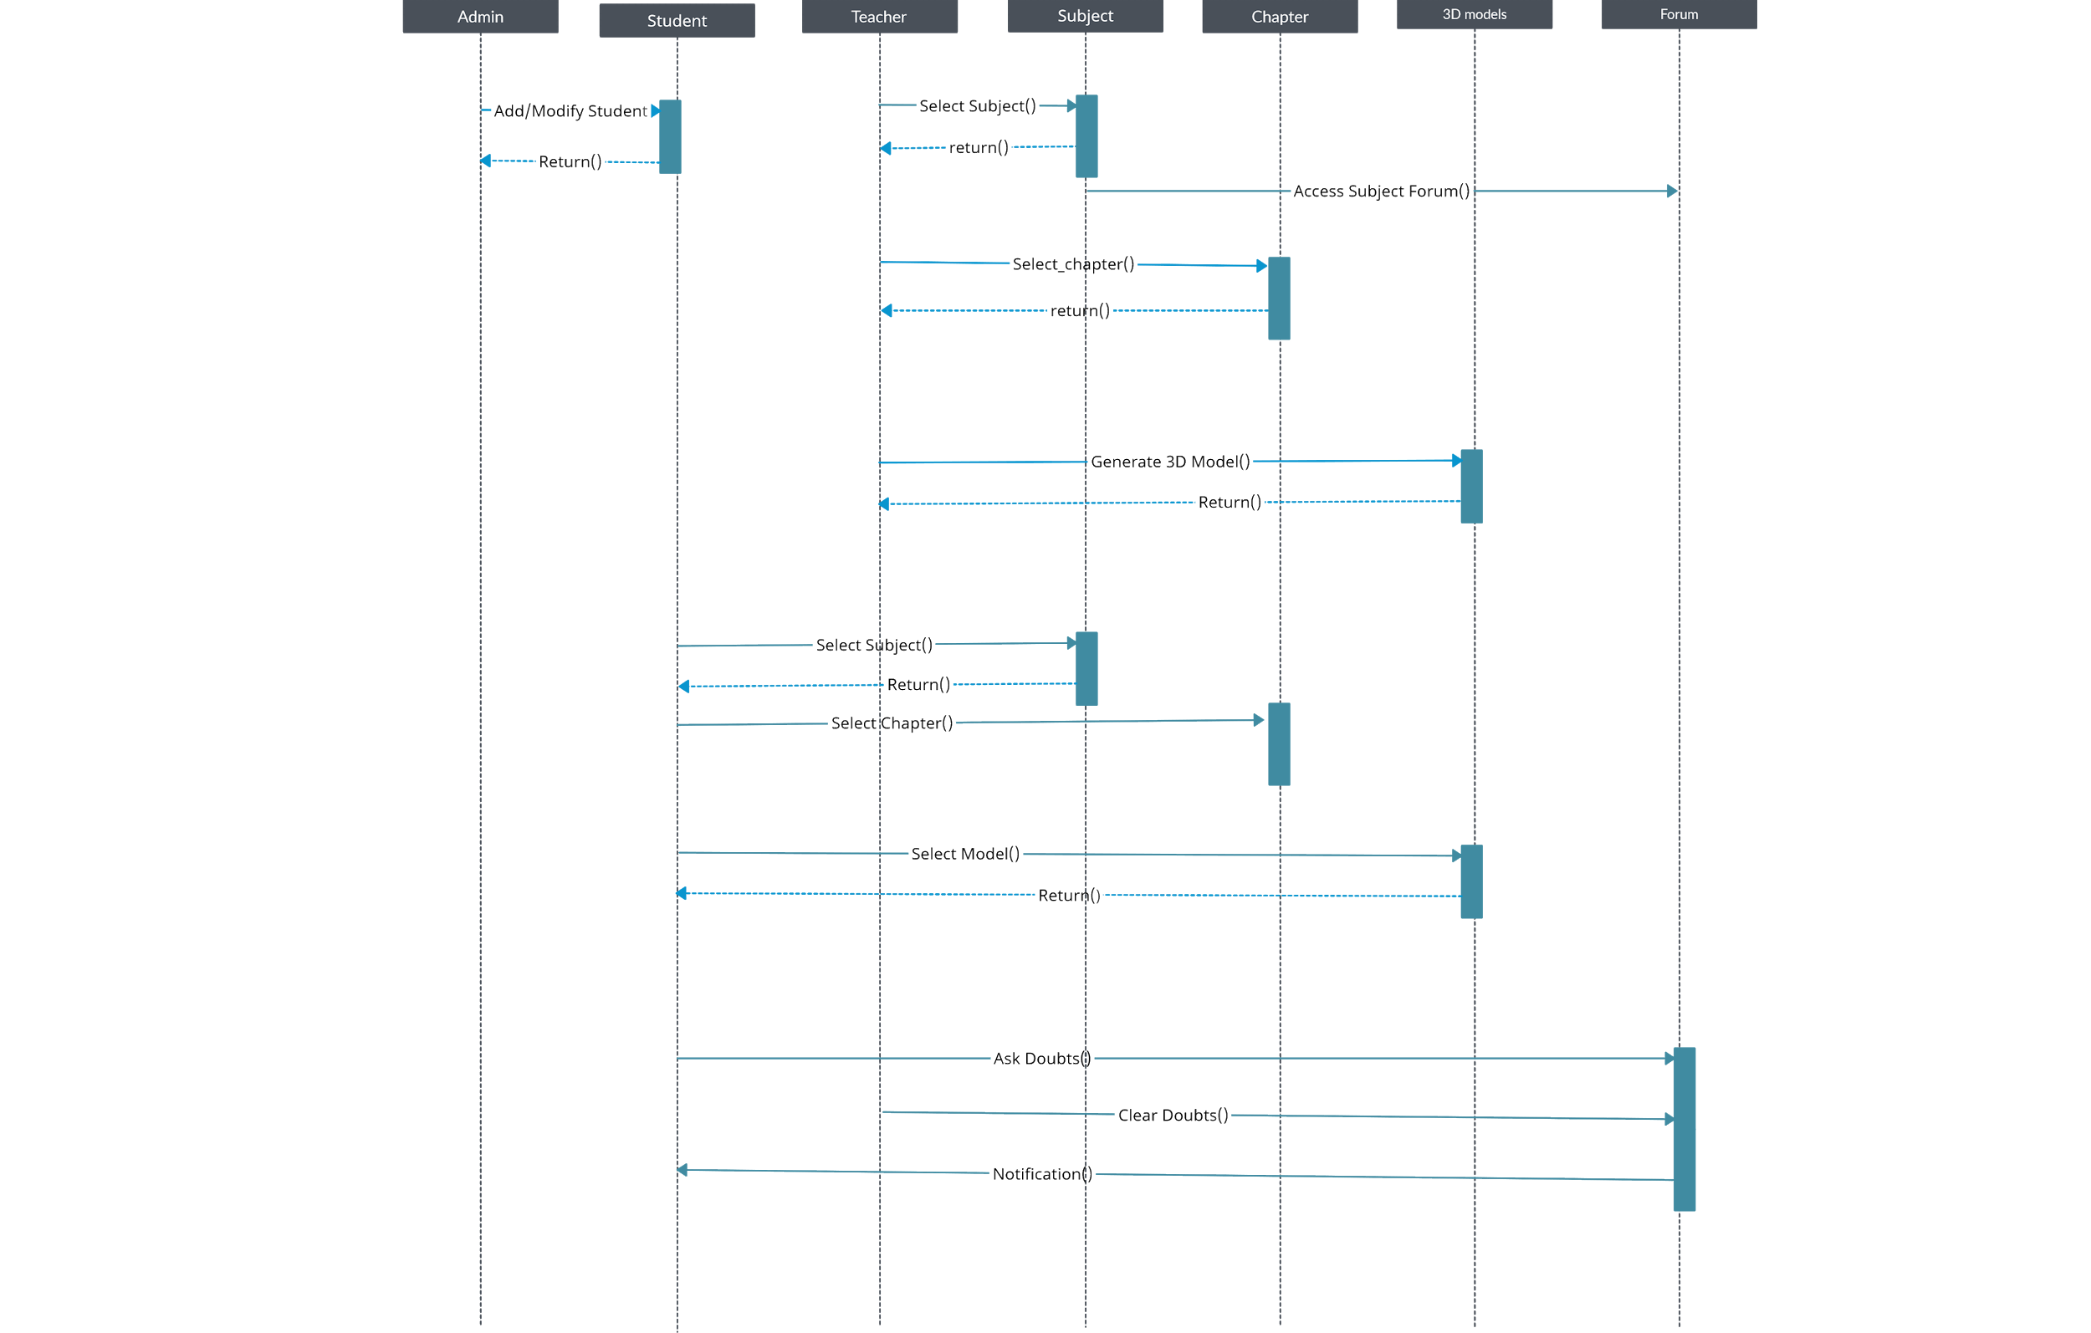
Sequence Diagram

Slide 11
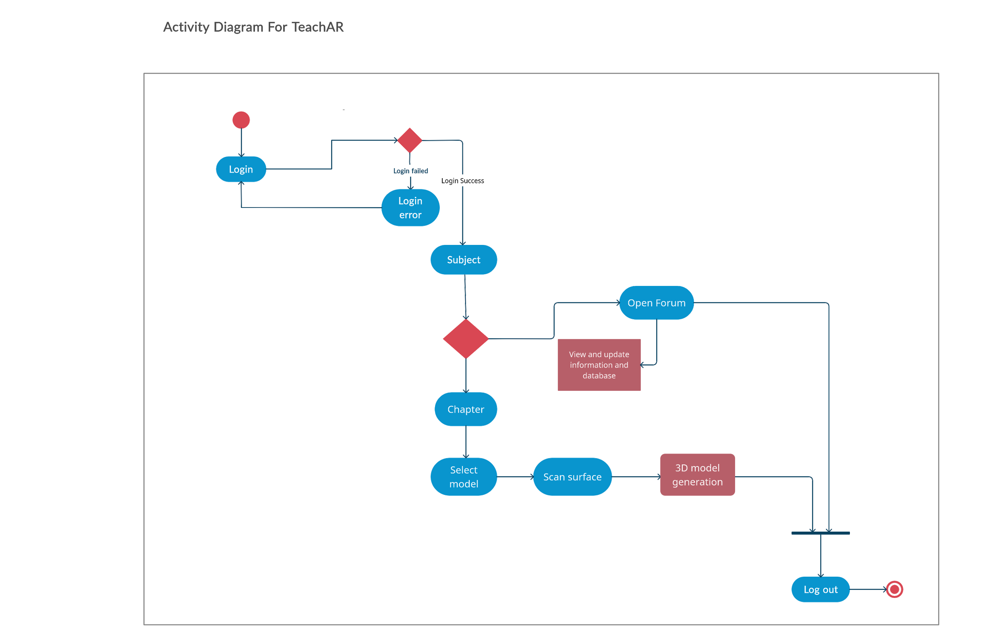
Activity Diagram

Slide 12
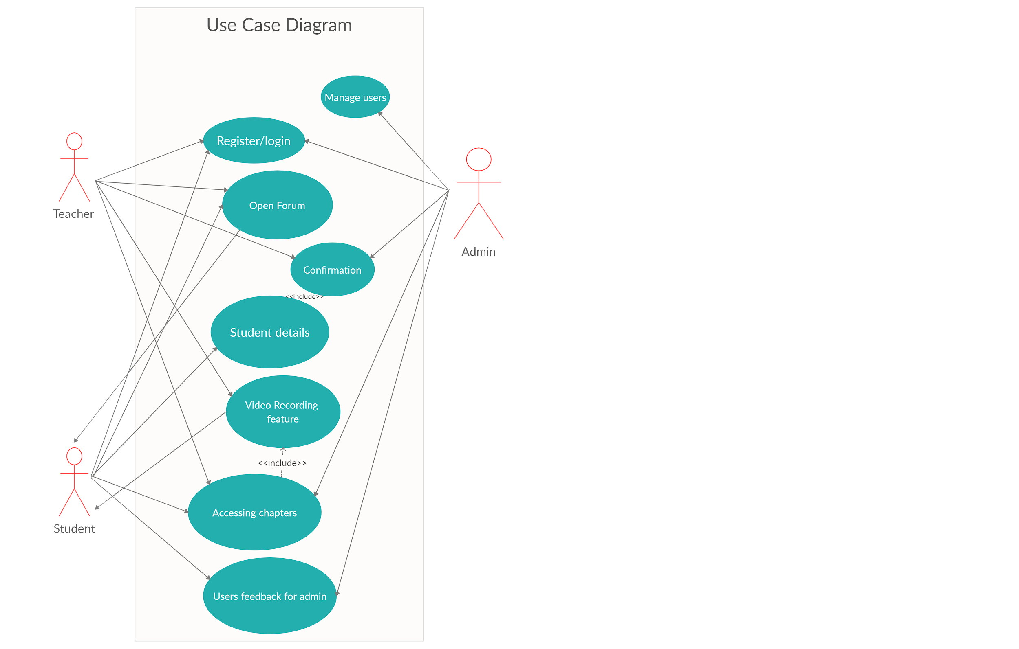
Use Case Diagram

Slide 13
Technology Used
SOFTWARE REQUIREMENTS
Unity 2019:This engine is used to create three-dimensional, two-dimensional, virtual reality, and augmented reality games, as well as simulations and other experiences
Blender 2.90: It is a free and open-source 3D computer graphics software toolset used for creating animated films, visual effects, art, 3D printed models, motion graphics, interactive 3D applications, virtual reality and computer games.
Vuforia 9.2:Vuforia is an augmented reality software development kit for mobile devices that enables the creation of augmented reality applications
Adobe Photoshop: It is a photo editing and manipulation software.

Slide 14
Technology Used
Adobe Xd:is a vector-based user experience design tool for web apps and mobile apps.
Creately:Is a visual collaboration tool with diagramming and design capabilities.
GitHub:it is a code hosting platform for version control and collaboration. It lets you and others work together on projects from anywhere.

Slide 15
References
[1] Infusory. 2020. Interactive Learning Through AR: Tutar | Next Reality Classroom - Infusory. [online] Available at: <https://infusory.in/interactive-learning-through-ar-next-reality-classroom/> [Accessed 18 October 2020].
[2]Edutopia. 2020. 6 Exciting AR Apps For Student Learning. [online] Available at: <https://www.edutopia.org/blog/ar-apps-for-student-learning-monica-burns> [Accessed 17 October 2020].
[3]Play.google.com. 2020. [online] Available at: <https://play.google.com/store/apps/details?id=com.AugmentedClass.AClass&hl=en_IN&gl=US> [Accessed 17 October 2020].
[4]Alive Studios | Reading and Math Programs for Early Education. 2020. Math Alive | Supplemental Math Program | Prek To 3Rd Grade | Alive Studios. [online] Available at: <https://alivestudiosco.com/math-alive-kit/> [Accessed 18 October 2020].
[5]https://iopscience.iop.org/article/10.1088/1742-6596/1237/2/022082/pdf
[6]https://www.hindawi.com/journals/ahci/2019/7208494/#literature-review

Slide 16
Thank You

